Slide 1
DATA VISUALISATION
Lessons from: Manoj K Jangra

Slide 2
Data Visualisation
“Data visualization is the presentation of data in a pictorial or graphical format. It enables decision makers to see analytics presented visually, so they can grasp difficult concepts or identify new patterns.” Simon Samuel

Slide 3
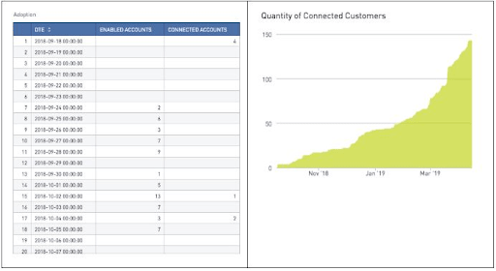
Why Data Visualisation???

Slide 4
Why is Data Visualization important?
We are visual creatures
We are 90% visual beings
We can understand visual information in an instant
We remember visually
Charts or graphs can be processed by the human brain easier than spread sheets or reports.

Slide 5
Is Data Visualisation a new thing?
The concept of using pictures to understand data is not new
It has been around for centuries, from maps and graphs in the 17th century
The pie chart was invented in the early 1800s
One of the most cited examples of statistical graphics dates back in 1869 when the Parisian engineer Charles Minard mapped Napoleon’s invasion of Russia
Minard’s viz is considered one of the most influential data visualisations and one of the world’s best infographics

